Slide 1
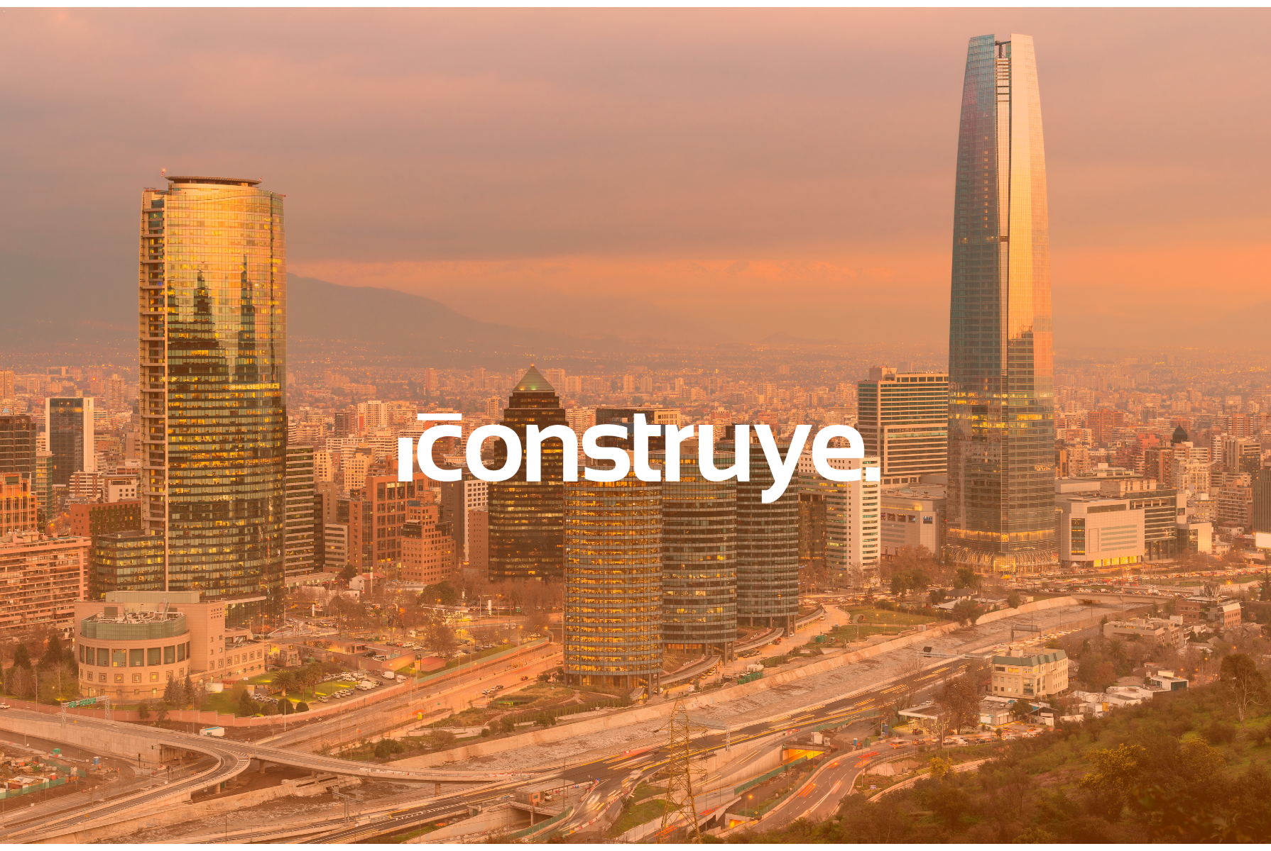
1- Portada
Notes:
textbox
No alt text provided
shape
No alt text provided
image
No alt text provided

Slide 2
4- Presentación 1
Notes:
shape
No alt text provided
textbox
No alt text provided
textbox
No alt text provided
textbox
No alt text provided
textbox
No alt text provided

Slide 3
5- Presentación 2
Notes:
Toda la información presentada aquí es basada en la actividad a través del ecosistema ICONSTRUYE, en el cual se gestiona más del 30% del PIB de la construcción de Chile
No alt text provided
textbox
No alt text provided
shape
No alt text provided
shape
No alt text provided
shape
No alt text provided
shape
No alt text provided
shape
No alt text provided
shape
No alt text provided
textbox
No alt text provided
image
No alt text provided

Slide 4
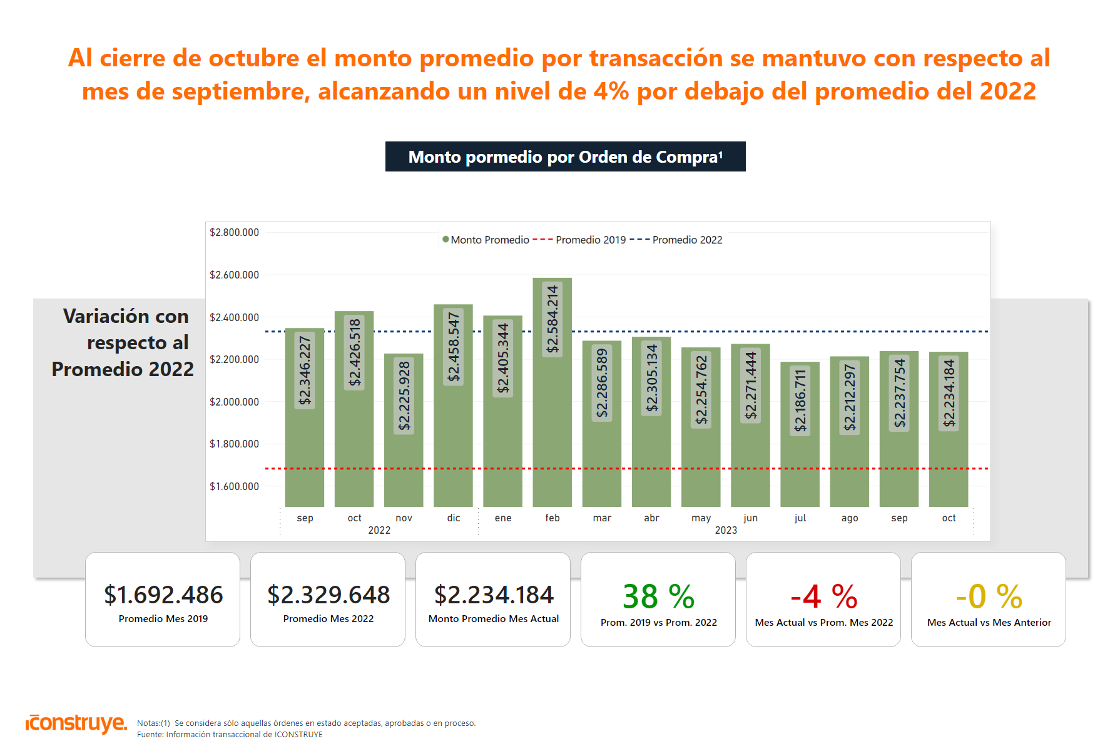
8- Ecosistema - $AVG por OC (base 2022)
Notes:
image
No alt text provided
textbox
No alt text provided
card
No alt text provided
textbox
No alt text provided
card
No alt text provided
textbox
No alt text provided
shape
No alt text provided
columnChart
No alt text provided
card
No alt text provided
card
No alt text provided
card
No alt text provided
card
No alt text provided
card
No alt text provided
image
No alt text provided

Slide 5
10-#OC por Obras (base 2022)
Notes:
image
No alt text provided
textbox
No alt text provided
card
No alt text provided
textbox
No alt text provided
card
No alt text provided
card
No alt text provided
card
No alt text provided
card
No alt text provided
textbox
No alt text provided
shape
No alt text provided
lineChart
No alt text provided
card
No alt text provided
card
No alt text provided
image
No alt text provided

Slide 6
11- $OC por Obras (base 2022)
Notes:
image
No alt text provided
textbox
No alt text provided
textbox
No alt text provided
card
No alt text provided
card
No alt text provided
card
No alt text provided
card
No alt text provided
lineChart
No alt text provided
textbox
No alt text provided
shape
No alt text provided
card
No alt text provided
card
No alt text provided
card
No alt text provided
image
No alt text provided

Slide 7
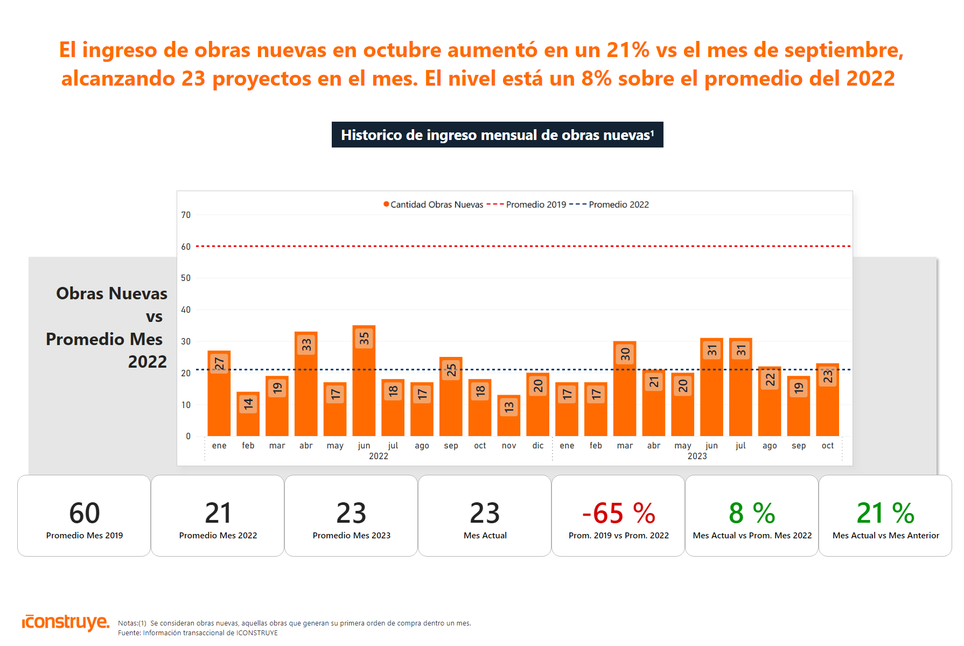
12- Histórico Obras Nuevas (base 2022)
Notes:
image
No alt text provided
textbox
No alt text provided
card
No alt text provided
textbox
No alt text provided
card
No alt text provided
card
No alt text provided
card
No alt text provided
card
No alt text provided
clusteredColumnChart
No alt text provided
textbox
No alt text provided
shape
No alt text provided
card
No alt text provided
card
No alt text provided
card
No alt text provided
image
No alt text provided

Slide 8
13- Ingreso Obras Nuevas
Notes:
image
No alt text provided
textbox
No alt text provided
card
No alt text provided
pivotTable
No alt text provided
donutChart
No alt text provided
textbox
No alt text provided

Slide 9
15.1- Obras - Variación% $OC por zona 1
Notes:
image
No alt text provided
textbox
No alt text provided
card
No alt text provided
Zona Norte
No alt text provided
image
No alt text provided
textbox
No alt text provided
card
No alt text provided
card
No alt text provided
card
No alt text provided
card
No alt text provided
shape
No alt text provided
image
No alt text provided

Slide 10
15.2- Obras - Variación% $OC por zona 1
Notes:
image
No alt text provided
textbox
No alt text provided
card
No alt text provided
Región Metropolitana
No alt text provided
image
No alt text provided
textbox
No alt text provided
card
No alt text provided
card
No alt text provided
card
No alt text provided
card
No alt text provided
shape
No alt text provided
actionButton
No alt text provided
image
No alt text provided

Slide 11
15.3- Obras - Variación% $OC por zona 2
Notes:
image
No alt text provided
textbox
No alt text provided
card
No alt text provided
Zona Centro
No alt text provided
image
No alt text provided
textbox
No alt text provided
card
No alt text provided
card
No alt text provided
card
No alt text provided
card
No alt text provided
shape
No alt text provided
image
No alt text provided

Slide 12
15.4- Obras - Variación% $OC por zona 2
Notes:
image
No alt text provided
textbox
No alt text provided
card
No alt text provided
Zona Sur
No alt text provided
image
No alt text provided
textbox
No alt text provided
card
No alt text provided
card
No alt text provided
card
No alt text provided
card
No alt text provided
shape
No alt text provided
image
No alt text provided

Slide 13
16.1- Obras - Variación% $OC por region
Notes:
image
No alt text provided
textbox
No alt text provided
card
No alt text provided
clusteredBarChart
No alt text provided
textbox
No alt text provided
tableEx
No alt text provided
shape
No alt text provided

Slide 14
16.2- Obras - Variación% $OC por region
Notes:
image
No alt text provided
textbox
No alt text provided
textbox
No alt text provided
card
No alt text provided
clusteredBarChart
No alt text provided
textbox
No alt text provided
shape
No alt text provided
tableEx
No alt text provided

Slide 15
22- Obras Activas - Etapas
Notes:
image
No alt text provided
textbox
No alt text provided
card
No alt text provided
pivotTable
No alt text provided
donutChart
No alt text provided
textbox
No alt text provided

Slide 16
23- Obras Activas- Tipo
Notes:
image
No alt text provided
textbox
No alt text provided
card
No alt text provided
pivotTable
No alt text provided
donutChart
No alt text provided
textbox
No alt text provided

Slide 17
24- Distribución por Etapa Constructiva
Notes:
image
No alt text provided
textbox
No alt text provided
card
No alt text provided
% Distribución por Etapa Constructiva
No alt text provided

Slide 18
25- Proyectos por Tipo de Obra
Notes:
image
No alt text provided
textbox
No alt text provided
card
No alt text provided
Proyectos Tipo de Obra
No alt text provided

Slide 19
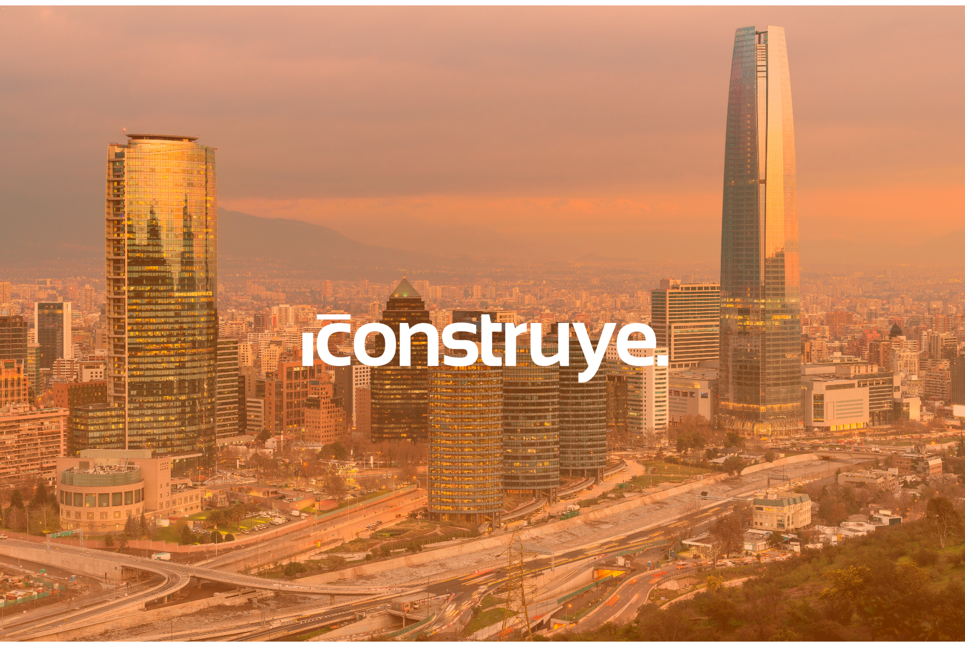
27- Cierre
Notes:
textbox
No alt text provided
shape
No alt text provided
image
No alt text provided

